Slide 1
TITLE I - PART C MIGRANT EDUCATION PROGRAM Annual Directors Meeting April 22, 2022

Slide 2
OMEC Office
José Salinas - Director
Gloria Altamirano - Project Director
Malena Gutierrez - State ID&R Coordinator
Pat Kingsborough - Office Manager
Page Warner – Education Coordinator
Lisa Florez - Health Fair Coordinator
Corina Barranco - State Migrant Liaison

Slide 3
State & Federal Updates
Rasha Hetata - Title I-C Migrant Coordinator

Slide 4
State Updates
Title I-C Request for Proposal (NA/SDP/Evaluation)
FY22 Federal Programs Spring Regionals - Live Labs
Friday, May 6, 2022: Gallia-Vinton ESC University of Rio Grande 218 N. College Ave. Rio Grande, OH 45674
Live Lab Session: 9:00 a.m. – 11:30 p.m. or 12:30 – 3:00 p.m.
Monday, May 9, 2022: ESC of Northeast Ohio 6393 Oak Tree Boulevard, South Independence, OH 44131
Live Lab Session: 9:00 a.m. – 11:30 p.m. or 12:30 – 3:00 p.m.
Tuesday, May 10, 2022: Hamilton County ESC 11083 Hamilton Avenue, Cincinnati, OH 45231
Live Lab Session: 9:00 a.m. – 11:30 p.m. or 12:30 – 3:00 p.m.
Friday, May 13, 2022: ESC of Lake Erie West 2275 Collingwood Boulevard, Toledo, OH 43620
Live Lab Session: 9:00 a.m. – 11:30 p.m. or 12:30 – 3:00 p.m.
Additional Live Lab Sessions: Ohio Department of Education 25 South Front Street Columbus, OH 43215
Thursday, May 12, 2022 9:00 – 11:30 a.m. and 12:30 – 3:00 p.m.
Thursday, May 17, 2022 9:00 – 11:30 a.m. and 12:30 – 3:00 p.m.

Slide 5
Federal Updates
Child count data sources for FY 2025:
MSIX for Category I and Category II

Slide 6
USDOE Monitoring review – reporting issues
Documenting Child disability – IDEA-B Category
Performance Reporting | One of the School Districts reviewed reported to OME reviewers that in summer 2021, five of its 40 migratory students had a disability and, as such, should be coded as children with disabilities (IDEA). In a review of ODE’s initial CSPR/EDFacts submission for File Specification (FS) 121, ODE reported zero migratory children with disabilities (IDEA). ODE also reported zero migratory children with disabilities (IDEA) for SY 2020-2021 in the Program Overview slides the SEA submitted as a part of this review.
Notes:
ID&R Quality Control
Office of Migrant Education (OME) found that two COEs were missing comments regarding the recruiter’s determination that the worker actively sought qualifying work soon after the move.
MSIX
Several Minimum Data Elements (MDEs) were missing including: 90.6% of English Learner Indicator (MDE 43); 99.57% of IEP Indicator (MDE 44); 99.22% of Med Alert Indicator (MDE 46); 84.19% of [Priority for Services] PFS Flag (MDE 47); 100% of Designated Graduation School (MDE 48); 100% of Home School Indicator (MDE 69); and 93.9% of Algebra 1 or Equivalent indicator (MDE 76).

Slide 7
ESSER – Flexibility
Allowable uses of funds
Activities to address the unique needs of low-income children or students, children with disabilities, English learners, racial and ethnic minorities, students experiencing homelessness, and foster care youths, including how outreach and service delivery will meet the needs of each population.
The expenditure must be an allowable activity under the CARES Act. The allowable uses of ESSER Funds are outlined in Section 18003(d) of the CARES Act

Slide 8
What additional funds can we give staff and teachers for their hard work?
◦ Must have the link to COVID
◦ Be reasonable and necessary
Premium Pay - Yes! (ESSER FAQs D-6)
◦ Pursuant to an established plan (in response to pandemic)
◦ Consistent with applicable collective bargaining agreements (2 CFR 200.430(f))
Overtime – Yes! (ESSER FAQs D-1, D-4)
Recruitment/Relocation Bonuses – Yes!
Even for non-teaching staff (paras, counselors, etc.) – Yes!

Slide 9
Addressing Staff Shortages
Using American Rescue Plan funds and other federal supports to address staff shortages:
https://www2.ed.gov/documents/coronavirus/arp-staff-shortages.pdf
Educator Licensure flexibility due to COVID:
http://education.ohio.gov/topics/reset-and-restart/educator-licensure

Slide 10
Allowable activities – Supplement, NOT Supplant
Question C7 of the MEP Non-Regulatory Guidance (NRG) states that reasonable expenditures for refreshments or food provided during parent meetings or training are allowable, particularly when such meetings extend through mealtime. The NRG does not distinguish between snacks and a meal. As long as there is a connection to a programmatic purpose and the cost is reasonable, a State or subgrantee may provide food at MEP parent meetings.

Slide 11
Q. Can Migrant Education Program (MEP) funds be used to provide food for eligible migratory families as a stopgap measure when other resources are not available?
Services such as the provision of food for eligible migratory families should be provided by non-MEP local programs such as a community food bank. If such programs are not available however, the Office of Migrant Education (OME) suggests that you use the factors listed below to consider the possibility of using MEP funds to provide food for eligible migratory children only so long as other programs are not able to provide this service.
The activity or service comports with the results of the State’s Comprehensive Needs Assessment (CNA) and the strategies outlined in the State’s Service Delivery Plan (SDP).
MEP funds are first used to meet the identified needs of migratory children that result from their migratory lifestyle, and to permit these children to participate effectively in school.
The activity or service meets the needs of migratory children that are not addressed by services available from other Federal or non-Federal programs;
MEP funds are used to supplement, rather than supplant, the use of non-Federal funds.
The costs of the service or activity must comport with the cost principles described in the Uniform Guidance (Subpart E of 2 Code of Federal Regulations (CFR) Part 200). The cost principles require, among other things, that costs of the service or activity be reasonable and necessary, and be allocable (or chargeable) to the MEP relative to the benefit received.

Slide 12
Q. May Migrant Education Program (MEP) funds be used to pay for meals and snacks for migratory students on field trips?
If there are no other resources available, MEP funds may be used to pay for the costs of food while the migratory children are participating in the field trip, as long as the State MEP abides by the criteria that all State educational agencies (SEAs) and local operating agencies (LOAs) must consider when determining if they may use MEP funds for a particular activity or (instructional or support) service:
The activity or service comports with the results of the State’s Comprehensive Needs Assessment (CNA) and the strategies outlined in the State’s Service Delivery Plan (SDP).
MEP funds must first be used to meet the identified needs of migratory children that result from their migratory lifestyle, and to permit these children to participate effectively in school.
The activity or service meets the needs of migratory children that are not addressed by services available from other Federal or non-Federal programs.
MEP funds are used to supplement, rather than supplant, the use of State and local funds.
The costs of the service or activity be reasonable and necessary, and be allocable (or chargeable) to the MEP relative to the benefit received. See MEP Non-Regulatory Guidance, Chapter X, Questions F1-F3 for additional information.
In terms of numbers 3 and 4 in the list above, documentation of your efforts to investigate non-MEP resources is important for quality control. It also serves as evidence of compliance with the statute in case of a State or Federal monitoring or audit. For example, if you speak with service agencies, another Federal program director, or local educational agency officials, be sure to document the name and title of individuals you spoke with and the date of the conversation.

Slide 13
Title I-C drawdowns
 | FY22 | FY21 carryover | FY20 carryover
Old Fort | $171,850 | $127,380 | $121,962
Marlington Local | $115,540 | $24,987 | $3,580
Willard City | $125,966 | $173,158 | $64,633
Putnam County ESC | $146,406 | $58,337 | $231,911
Tecumseh Local | $148,909 | $110,025

Slide 14
Title I-C Allocations
FY23 Allocations: $1,289,867
FY22 Allocations: $1,422,846
FY21 Allocations: $1,453,309

Slide 15
Monitoring
OH|ID app store
FY22 On-site (virtual):
Old Fort and Tecumseh
FY22 Self-Survey:
Willard, Putnam, Marlington and Northwest Ohio ESC – complete by May 31st 2022
FY23 On-site:
Putnam County ESC
FY23 Self-Survey:
Willard, Old Fort, Tecumseh Marlington and Northwest Ohio ESC

Slide 16
Title I-C Summer Extensions
History log comment with the following information;
Name of the grant requesting extension for;
Program dates – must be crossing over fiscal years;
Assurance that FERs will be filed by September 30th

Slide 17
José P. Salinas
Summer MEP Coordination
OMEC Director

Slide 18
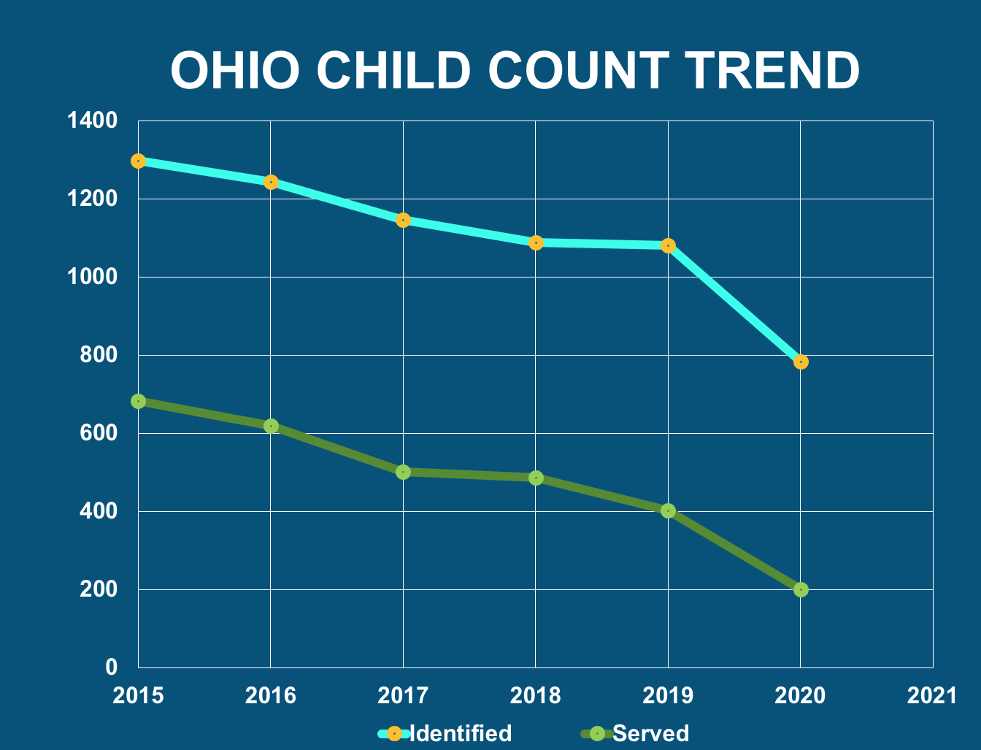
1,089
1,082
785
753
487
403
304
201

Slide 19
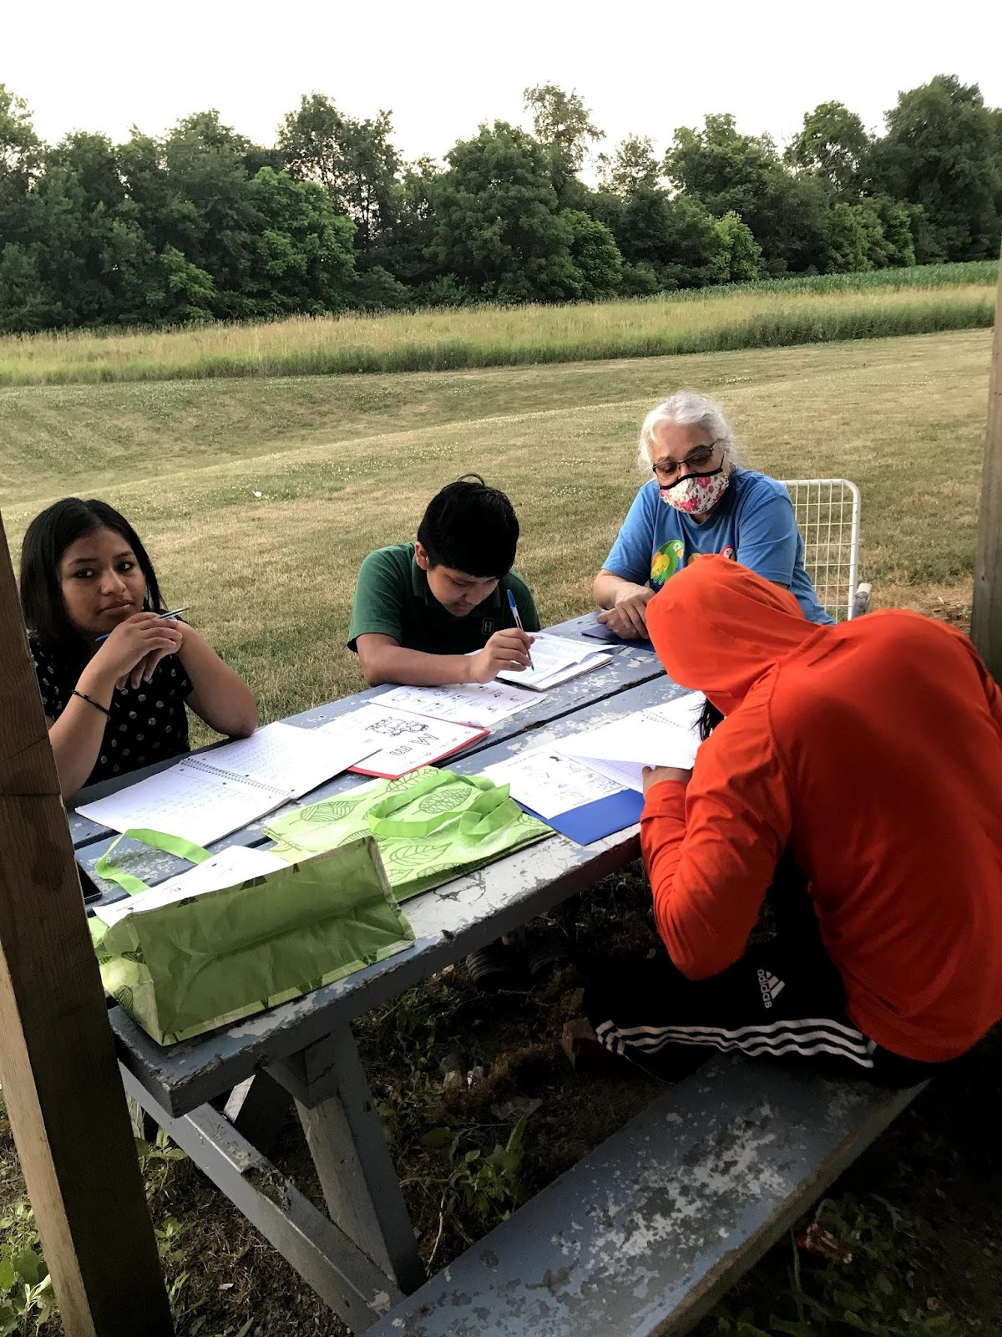
IMAGE Regional Programs
As per the Service Delivery Plan, all regional programs are required to provide IMAGE services.
IMAGE services are confined to June 1 – August 31.

Slide 20
IMAGE Summer Data
 | 2019 | 2020 | 2021
Marlington | 22 | COVID | 0
Old Fort | 22 | COVID | 0
Putnam Co. | 18 | COVID | 45
Tecumseh | 11 | COVID | 0
Willard | 25 | COVID | 66

Slide 21
Child-Count Data during COVID
 | 2019 | 2020 | 2021
Marlington | 22 | 25 | 0
Old Fort | 22 | 50 | 0
Putnam Co. | 18 | 69 | 45
Tecumseh | 11 | 15 | 0
Willard | 25 | 35 | 66

Slide 22
Online IPT Testing - Summer 2022
ORAL Assessment... (Required)
Used for identifying LEP students. This is a minimum data element that USDoE expects all states to collect.
Teachers are only required to pre-test on the student’s first day of attendance. No need to post-test at the end of the summer program.
Reading & Writing Assessment... (Optional)
Teachers are welcome to assess their students’ reading level or if they want to see a sample of their writing .
*You are welcome to use your OELPA data
to identify LEP students instead of the IPT

Slide 23
Summer iReady
All summer MEP projects will continue to use iReady
The quality lessons in Reading & Math
Provides the progress monitoring data we need to show growth in the programs
We will require a new list of teachers from your summer program
iReady is not a curriculum, it is a supplemental tool for teachers

Slide 24
Parent Involvement
Guest Speaker
Nutritional Program
Welding Demonstration by your Career Center
Organize an summer Literacy Program
You could even compensate parents for their mileage to the event, offer free childcare services during these events, and provide a free meal.

Slide 25
Parent Involvement?
BIG IDEAS

Slide 26
More Parent Involvement Ideas...
Imagination Station
Literacy Night
VR Sessions with Oculus
First Aid/CPR Training

Slide 27
June Inservice Dates
TECUMSEH
Teach Inservice
WILLARD
Teacher Inservice
MARLINGTON
Teacher Inservice
OLD FORT
Teacher Inservice
06
07
08
10
13
14
15
20
IMAGE TRAINING
Tecumseh
IMAGE TRAINING
Findlay
PUTNAM CO.
Teacher Inservice
IMAGE TRAINING
Open-TBA

Slide 28
Options/Information for Online Coursework through the Ohio Migrant Education Program
Gary Herman, APEX Coordinator
GaryHerman@PutnamCountyESC.org

Slide 29
APEX 2022 - Goals
Credit Accrual/Recovery – This should be the primary goal
Career Exploration
(limited under APEX)
Can have more options for additional cost
Remediation
Course List:
bit.ly/ApexMigrantCourseOptions

Slide 30
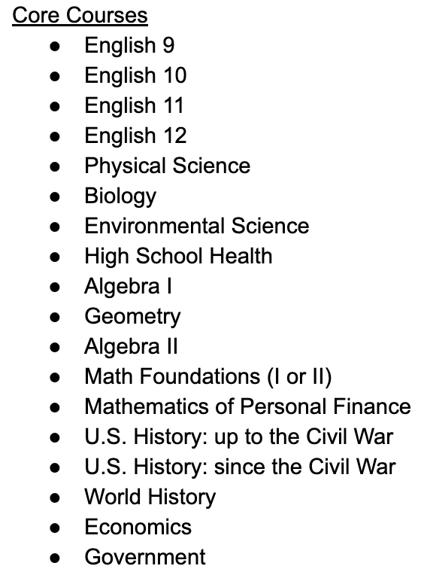
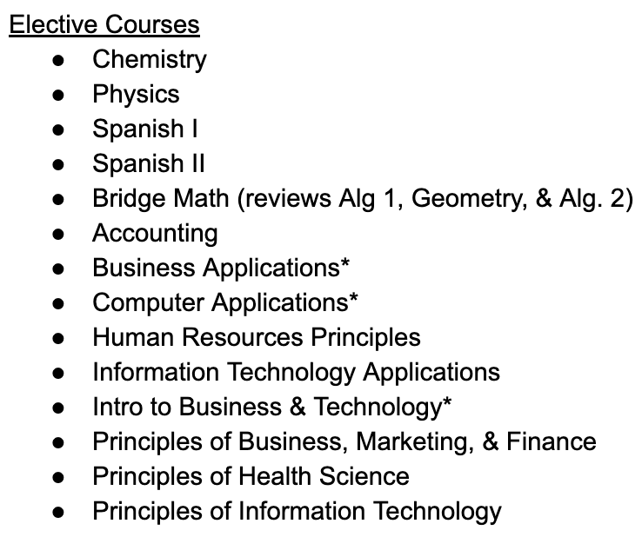
* = Semester course

Slide 31
APEX Registration Process
1. Contact Gloria for verification of course option
GAltamirano@nwoesc.org
2. Fill out online Registration Form: bit.ly/MigrantCourseRegistration
Person filling out request will receive a PDF copy to confirm it has been submitted. Link will be emailed to TR Clerks.
3. Please contact me if you are unsure or have any questions
Gary.Herman@putnamcountyesc.org

Slide 32
APEX Training
Friday, June 10th @ The University of Findlay
Time: TBA
Training will be recorded and shared

Slide 34
2023 National Migrant Education Conference
Albuquerque, N.M. April 30 – May 03
NASDME

Slide 35
Malena Gutierrez
Identification & Recruitment
State ID&R Coordinator

Slide 36
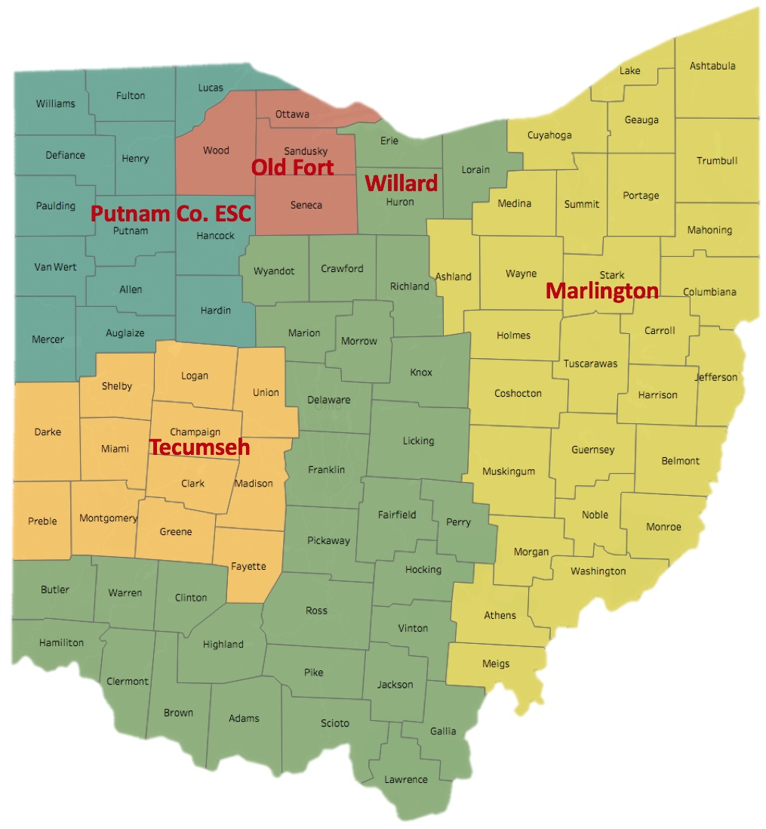
MEP Regional Model
Putnam Co. ESC
Tecumseh
Old Fort
Willard
Marlington

Slide 37
Maggie Hernandez
Serves most of of NW Ohio
Challenge in recruiting Marshallese families due to language and culture barriers
Currently working with Mercer county and IDRC to conduct a recruitment sweep of that population
Putnam County

Slide 38
Recruiter Needed
Maggie has been covering that area until a replacement is found.
Very limited canvassing opportunities because there is not a recruiter
Migratory pattern is more complex in some areas due to employer vetting
Strict immigration enforcement in certain areas
Tecumseh

Slide 39
Marta Dominguez
Betty Pacheco retired in 2021
Less families and more H2A workers
More challenge with employer cooperation in recruiting workers on-site.
Working on building stronger relationships with employers.
Old Fort

Slide 40
Janelle Watts
Newly hired recruiter to cover the area served by the Willard summer building program.
Limited recruitment duties until completing the recruiter certification training
Requires shadowing for the first few months as a new recruiter
Willard

Slide 41
Ada Reyes
Is covering the areas around Willard that are not served by the summer building program.
Has previously served multiple roles within the migrant education program
Will need to spend time shadowing the new recruiter
Willard

Slide 42
Marisa Gonzales
Is covering the city of Columbus and the surrounding areas.
Limited experience with recruiting due to the pandemic
Now that we are returning to in-person recruitment is willing to assist other recruiters in other regions
Willard

Slide 43
Recruiter Needed
Past data has shown identified migrant families
Very limited canvassing opportunities because there is not a recruiter
Willard

Slide 44
Emma Owens
Brianne Marsh will not be returning to recruit this season.
Assigned to cover the Marlington summer building program but also recruits nearby areas that are not served by the MEP.
Marlington

Slide 45
Recruiter(s) Needed
Past data has shown identified migrant families
Very limited canvassing opportunities because there is not a recruiter
Marlington

Slide 46
Pockets areas where recruitment representation is needed.
Currently in discussion with each MEP director about enhancing recruitment activities in their region
Open to discussing options for hiring new recruiters
Summary of Needs:

Slide 47
Field & Nursery Work
Packing/Canning fruits and vegetables
Dairy
Poultry
Livestock
Meat/Seafood Packing and/or Processing
Timber
Ohio’s established qualifying work:

Slide 48
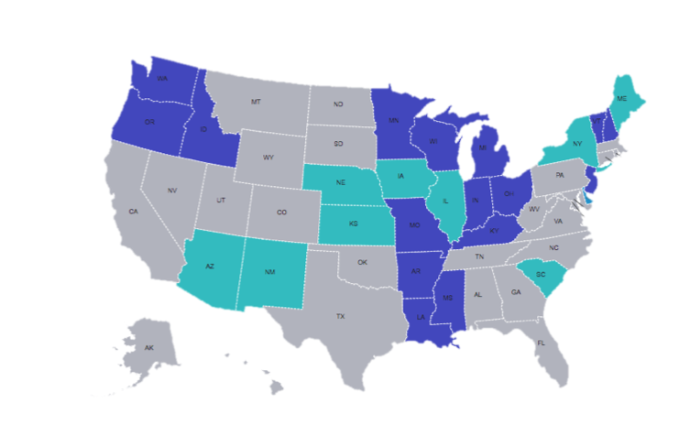
MEP Referral System
Ohio Administrators
Ohio Migrant Education Center (OMEC)
Secondary-Level Users
Recruiters
MEP Staff
Open Users
School Districts
Agencies/Organizations
Community Members
Parents/Guardians
Self-Referrals

Slide 49
MEP Referral System
idrreferrals.net
Connect to the MEP Referral System
Two minutes to complete entry
Default language is English, but is multilingual
Family contact information
Move & work history
Additional comments
QR Code

Slide 51
After a lead is created…
An email notification is sent to the state admins (OMEC) and the recruiter
The system automatically assigns a recruiter the lead based on the county of residence
The recruiter begins the journey to locate the family
Leads remain active until the recruiter officially closes them

Slide 52
MEP Referral System Benefits
User-Friendly
Automates Leads
Prompt Notifications
No PII Student Information
Built in tracking system

Slide 53
Gloria Altamirano
Records & Data Coordination
Project Director

Slide 54
Migrant Head Start
CLARK COUNTY
GLCAP New Carlisle MSHS 476 North Dayton-Lakeview Drive New Carlisle, OH 45344 513-399-8196
HENRY COUNTY
GLCAP Napoleon MSHS 910 Third Street Napoleon, OH 43545 419-419-1914
RICHLAND COUNTY
GLCAP Shiloh MSHS 26 Mechanic Street Shiloh, OH 44878 567-233-1980
SANDUSKY COUNTY
GLCAP Fremont MSHS 1499 N. River Road Fremont, OH 43420 567-202-1675
STARK COUNTY
GLCAP Hartville MSHS 61 Hartville Road Hartville, OH 44632 330-754-2331
No busing will be available for: NAPOLEON & HARTVILLE

Slide 55
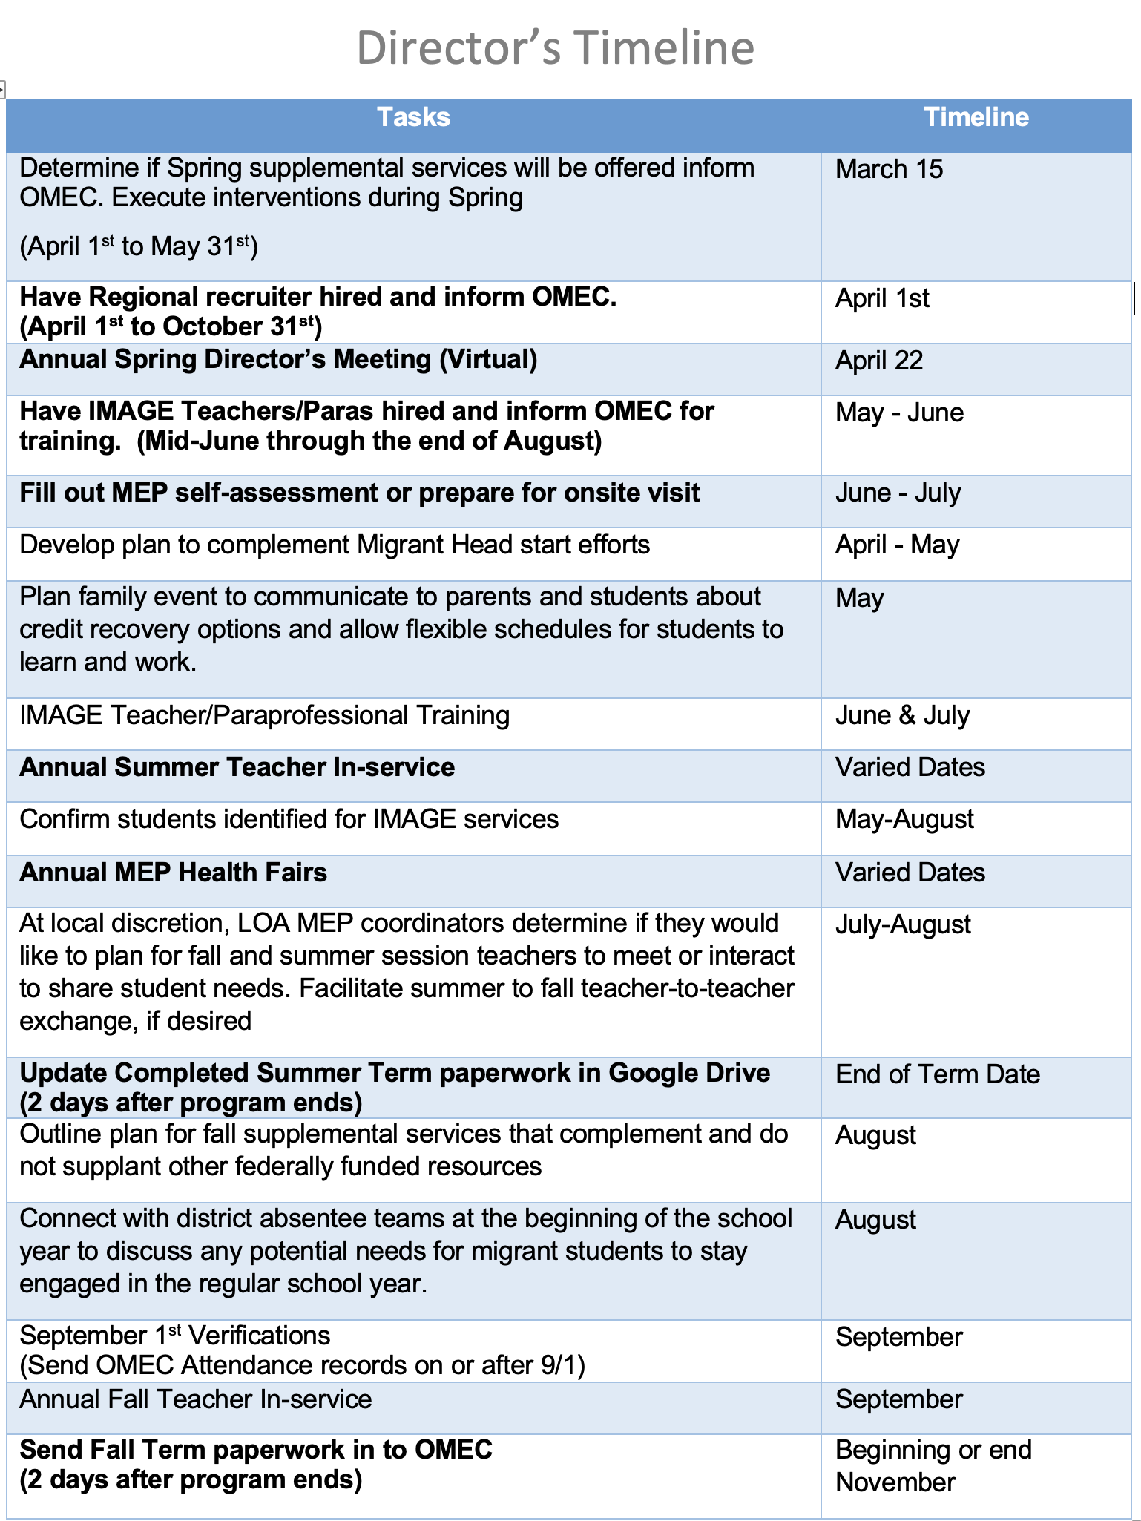
MEP Timeline Check Sheet

Slide 56
Parent Night/Event
Parent Night Documentation
Post Summary Report
Sign-in Sheet
Agenda

Slide 57
Continuation of Services (COS)
#1
Eligibility for Title I-C is only good for 36 months. COS allows the MEP to serve students who’s eligibility has expired for an additional 12 months.
#2
OMEC approval is required before COS is provided to any student.
#3
The reporting process for COS students is completely different from your migrant-eligible students.
#4
Students served through COS must be excluded from the official child count.
#5
Students must be “At-Risk of Failing” in order to be approved for COS.

Slide 58
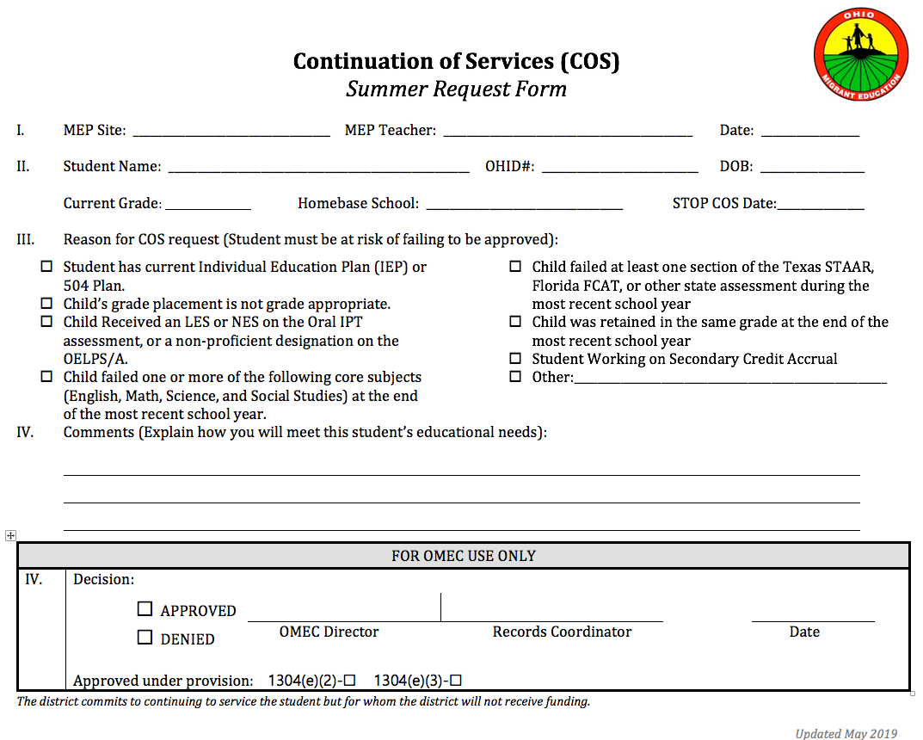

Slide 59
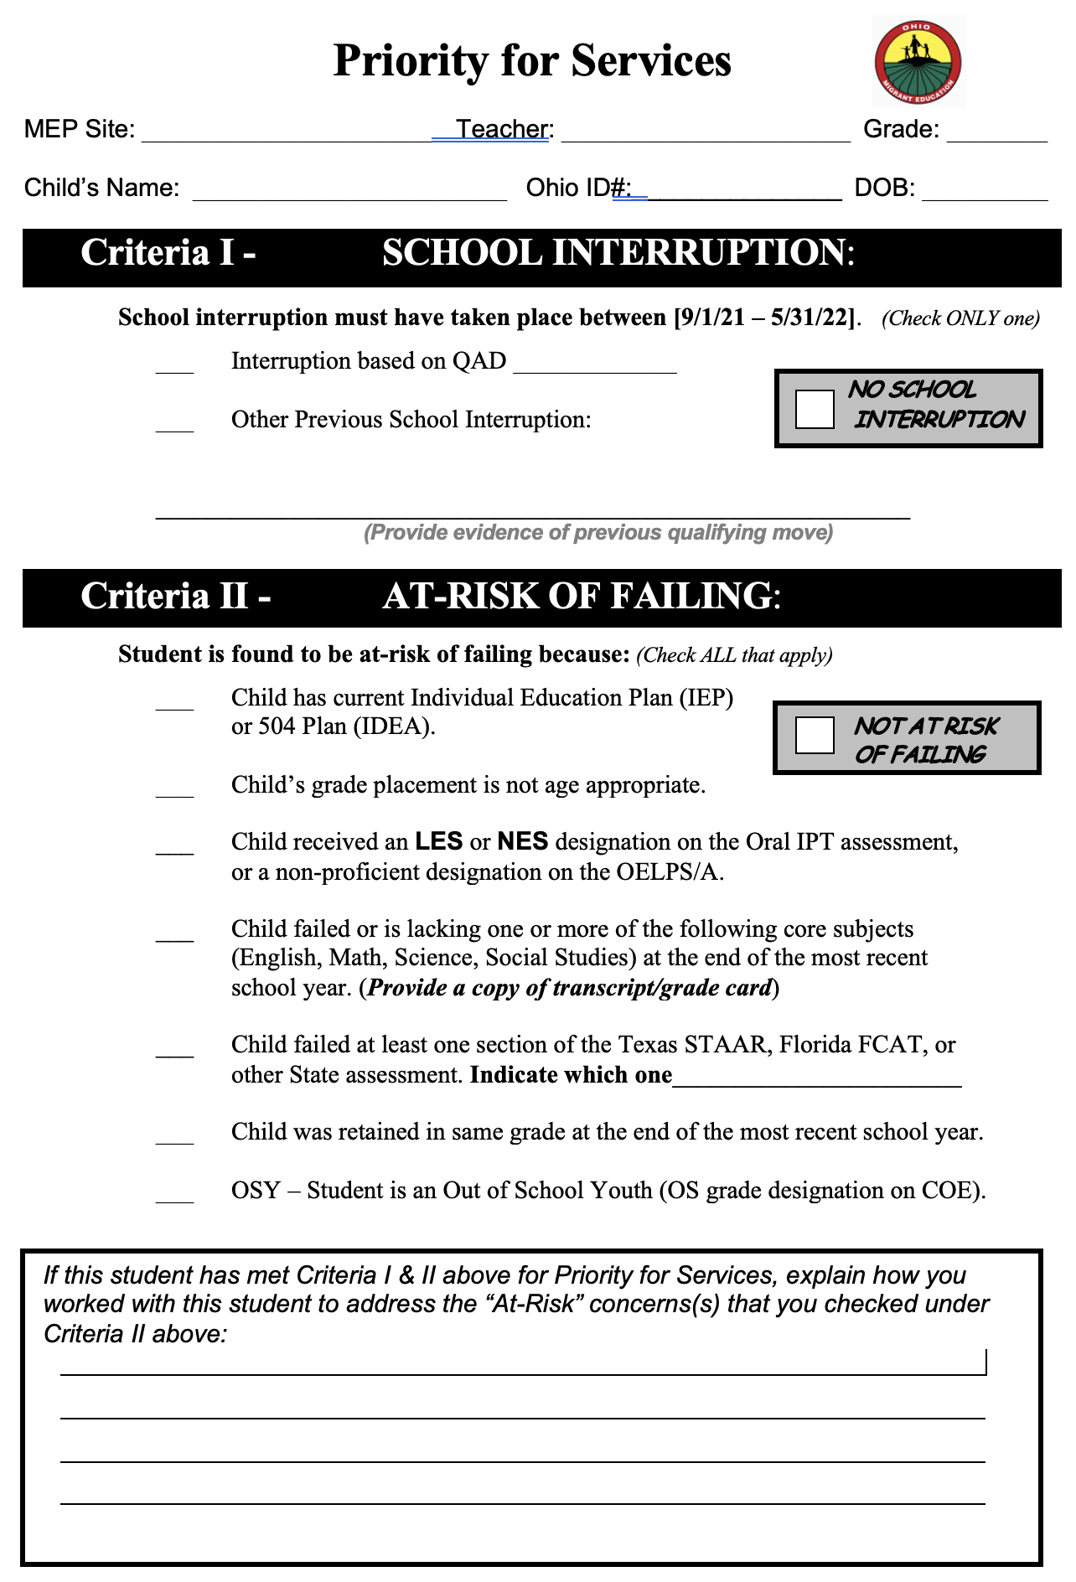
Priority for Services (PFS)

Slide 60
Using MSIX for Priority for Services
Determine a School Interruption -
Enrollment Date/Withdrawal Date (between 9/1/21– 5/31/22)
Last enrollment not in the current school year
Determine At Risk of Failing -
Is the student PFS in their homebase school
Do they have an IEP?
A Records Request must be done for every student K-12

Slide 61
Using MSIX to Determine MEP Services
State/Migrant ID, Name, DOB, Parents – Is this the right student?
Eligibility Expiration Date – To serve or not to serve.
Birth Date – What is their age? Building program or IMAGE services?
IEP? Request IEP from homebase school through an MSIX Records Request.
(4-day turnaround time)

Slide 62
Using MSIX for Enrollments
Enrollment Line
Grade Placement
Medical Alert
Immunizations
For summer-only, students must be enrolled in last grade completed

Slide 63
MSIX Privacy Protections
Lock your computer when leaving computer unattended.
Media (including reports) containing MSIX information should be stored and locked during non-business hours.
Do not leave paper media with MSIX information out where anyone can see.
Store digital information in an encrypted format.
Media containing MSIX information should be properly destroyed.
Do not disclose MSIX information to unauthorized individuals.
Use tools in Microsoft Office Suite or Acrobat Professional. The password should never be shared in email form. A phone call is best.

Slide 64
MSIX Privacy Protections
The State Service Delivery Plan clearly states that MEPs are required to use the MSIX consolidated record for viewing enrollment, placement, and credit accrual data as outlined in Ohio’s interconnection agreement (IA). All MEP TR Clerks are trained by the State Transfer Records Coordinator and expected to utilize the MSIX system.

Slide 65
Important Deadlines
FTE Worksheet
Summer – when staffing is complete
Fall – End of Term
MEP Program Calendar – ASAP
MEP paperwork due 2 days after last day of any term

Slide 66
THANKS!
Any questions?
Call OMEC
419-332-6007

